Slide 1
Student Performance Analysis (EDA)
By- Nagesh B

Slide 2
Table of Content
1.Problem Statement
2.Importing Packages and Dataset
3.Data Profiling
3.1 Understanding the Dataset
3.2 Pre Profiling
3.3 Preprocessing
3.4 Post Profiling

Slide 3
Table of Content
4.EDA
4.1 Final Grade Distribution
4.2 Correlation Heatmap
4.3 Romantic Status
4.4 Alcohol Consumption
4.5 Parents Education Level
4.6 Frequency Of Going Out
4.7 Desire Of Higher Education
4.8 Urban Vs. Rural Students
5.Conclusions

Slide 4

1.Problem Statement
This data approach student achievement in secondary education of two Portuguese schools. The data attributes include student grades, demographic, social and school related features and it was collected by using school reports and questionnaires. Two datasets are provided regarding the performance in two distinct subjects: Mathematics (mat) and Portuguese language (por).
I have classified these students into three categories, "good", "fair", and "poor", according to their final exam performance. Then I analyzed a few features that have significant influence on students' final performance, including Romantic Status, Alcohol Consumption, Parents Education Level, Frequency Of Going Out, Desire Of Higher Education and Living Area.

Slide 5
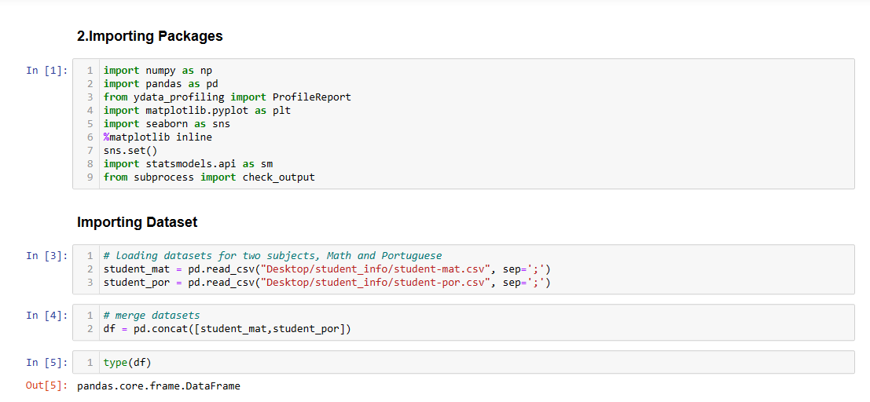
2.Importing Packages

Slide 6
3. Data Profiling
In the upcoming sections, we will begin by utilizing various pandas functionalities to gain a comprehensive understanding of our dataset.
Following that, we will employ pandas profiling to identify the columns in our dataset that require preprocessing.
During the preprocessing stage, we will address erroneous and missing values in these columns.
Lastly, we will generate another pandas profiling report to assess the transformation brought about by the preprocessing steps in our dataset.
3.1 Understanding the Dataset
To extract valuable insights from the data, it is essential to thoroughly examine each aspect of it. We will initiate this process by carefully observing a few rows and columns of data, starting from the beginning and also from the end.

Slide 7
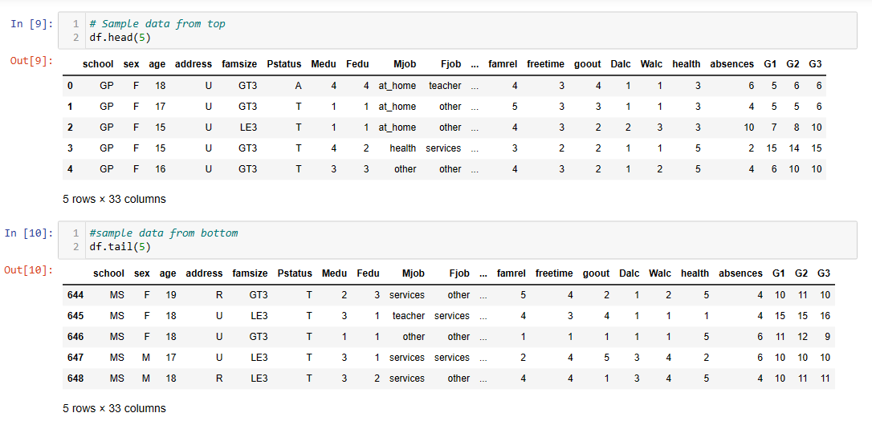
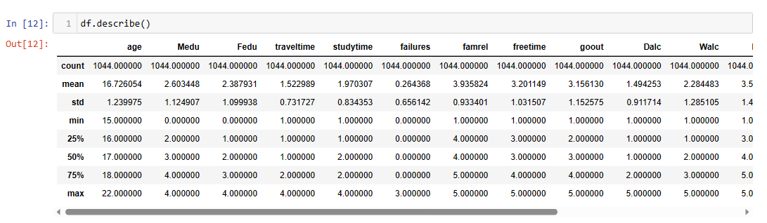
Understanding the Dataset

Slide 8
3.2 Pre Profiling
Pandas profiling generates an interactive HTML report that provides comprehensive information about the dataset columns, including counts and data types.
It offers detailed insights into each column, such as correlations with other columns and a sample of the dataset.
The report facilitates visual interpretation of each column through distribution plots, enabling a better understanding of data spread.
Furthermore, it allows for a granular level analysis of each column, providing in-depth exploration of its characteristics.
3.3 Preprocessing
Renamening the columns
Need to create G3 column as categorical variables as good,fair and poor

Slide 9
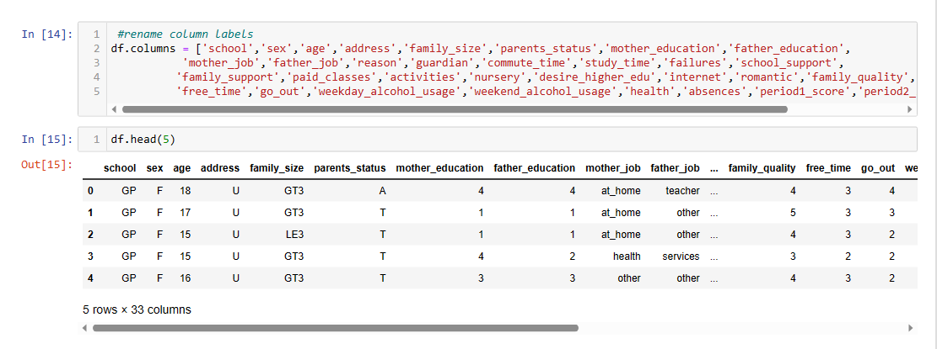
3.3 Preprocessing

Slide 10
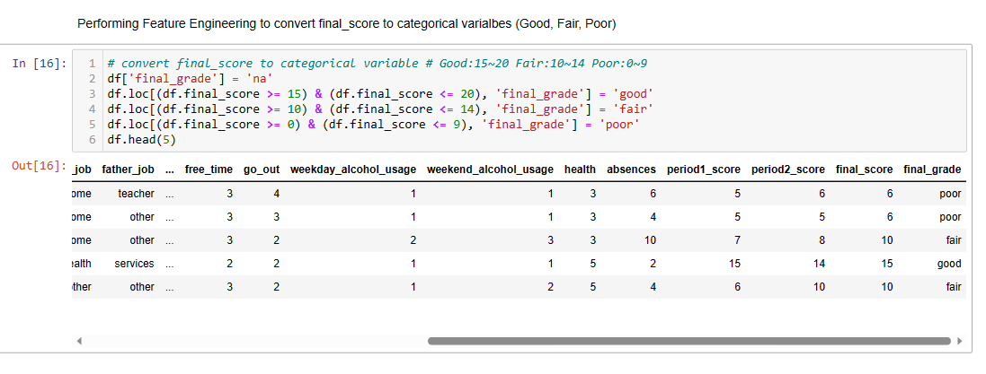
Feature Engineering

Slide 11
3.4 Post Pandas Profiling
Now we have preprocessed the data, now the dataset doesnot contain missing values, we have also introduced new feature named Final_grade. So, the pandas profiling report which we have generated after preprocessing will give us more beneficial insights. You can compare the two reports, i.e df_after_preprocessing.html and df_before_preprocessing.html. In df_after_preprocessing.html report, observations:
Number of variables = 34
Observe the newly created variable Final_grade, Click on Toggle details to get more detailed information about it.

Slide 12
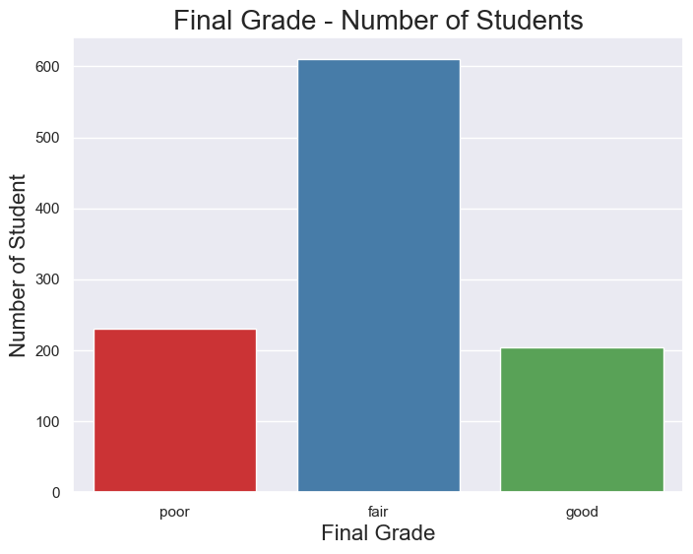
4. Exploratory Data Analysis
4.1 Final Grade Distribution
The majority of students have received a grade of Fair

Slide 13
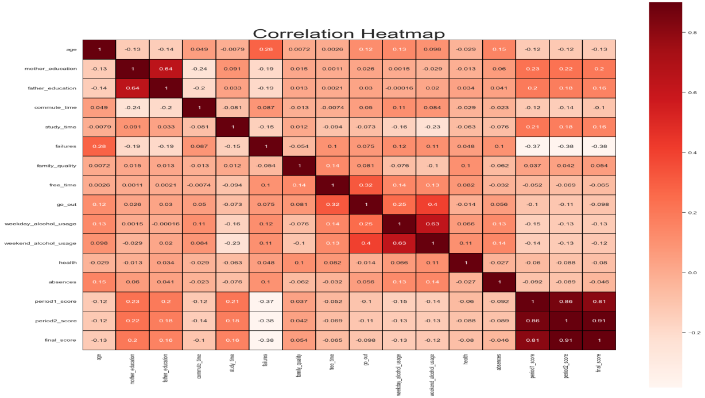
4.2 Correlation Heatmap
final_score, period_score. are negatively. correlated with failure.
period_score. are positively. correlated with final_score.
mothers_edu, fathers_edu. have _positive effect on final_score.

Slide 14
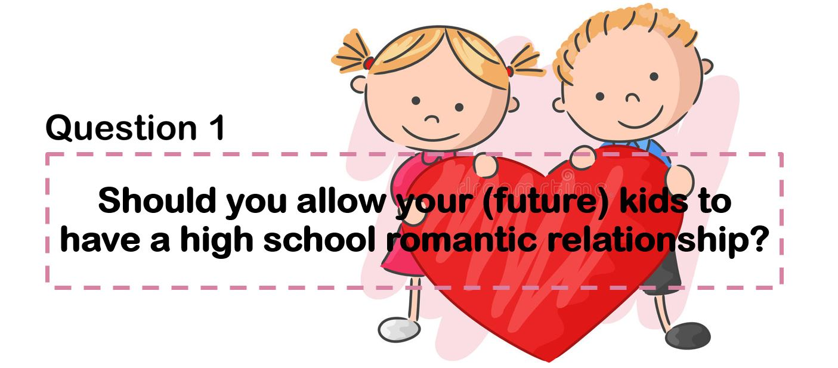
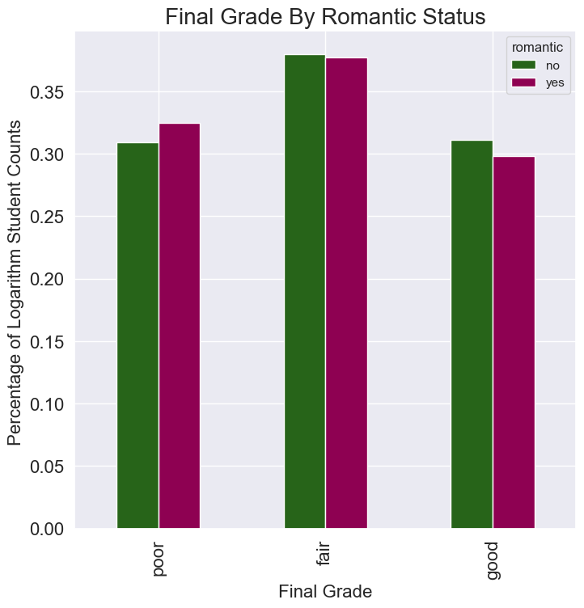
4.3 Final Grade By Romantic Status
The romantic status exhibits a noteworthy correlation with the final grade.
A majority of the students do not have a romantic status

Slide 15
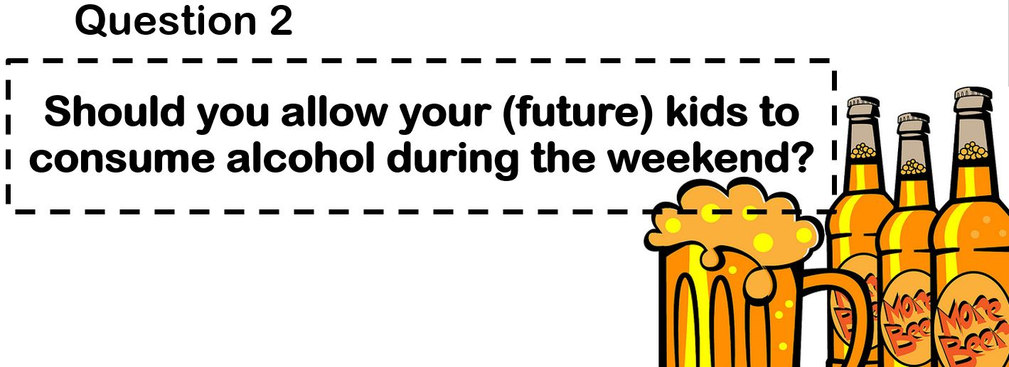
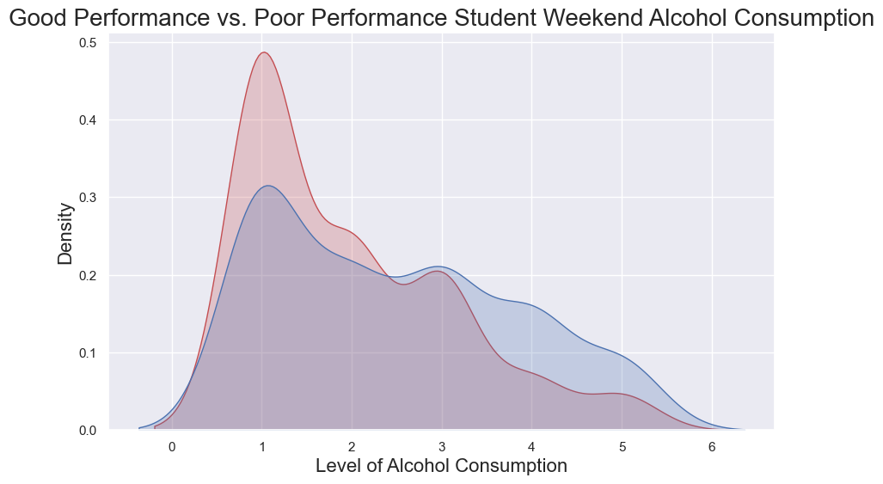
4.4 Final Grade By Alcohol Consumption

Slide 16
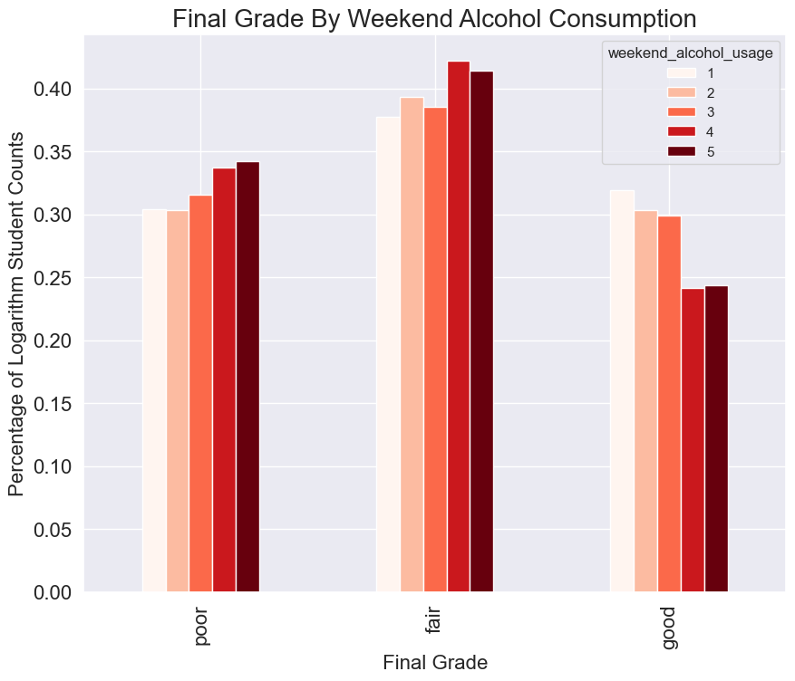
4.4 Final Grade By Alcohol Consumption
Weekend alcohol consumption demonstrates a notable correlation with the final grade
The majority of students have an alcohol consumption level of one
We can also observe that students who perform well academically tend to have lower alcohol consumption levels, whereas students with poor or fair academic performance have higher levels of alcohol consumption.

Slide 17


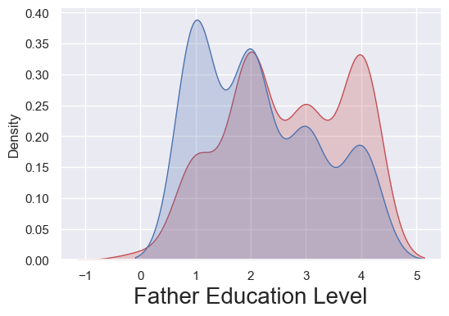
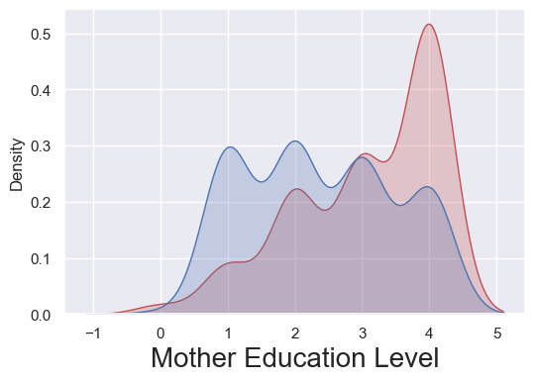
4.5 Final Grade By Parents Education Level
The educational background of the father directly influences the academic performance of the student
The educational attainment of the mother plays a crucial role in facilitating high academic performance among students
When comparing the educational backgrounds of both fathers and mothers, it becomes evident that the academic performance of students is greatly influenced by the mother's level of education.

Slide 18
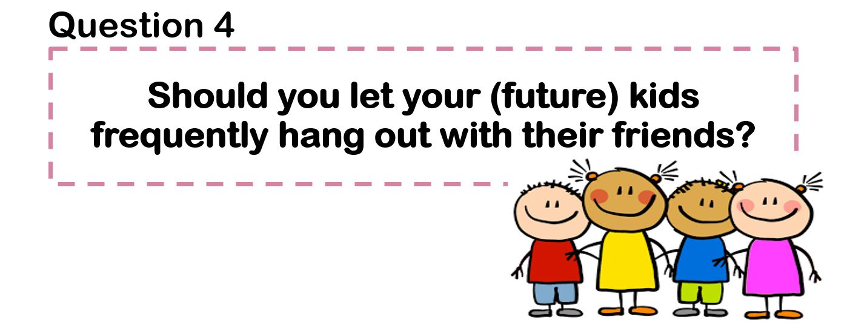
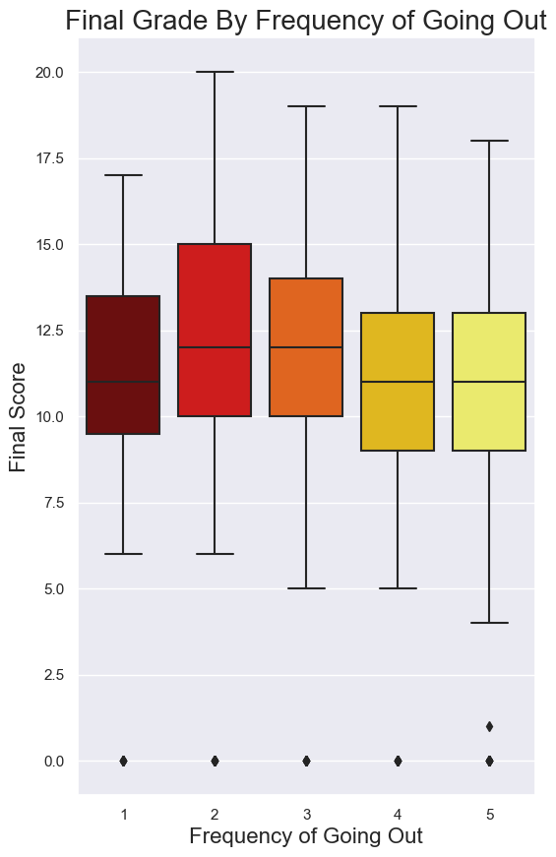
4.6 Final Grade By Frequency Of Going Out

Slide 19
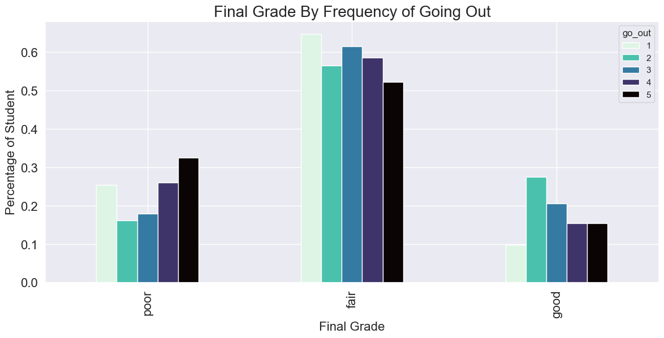
4.6 Final Grade By Frequency Of Going Out
There exists a significant correlation between the frequency of socializing with friends and students' final performance.
Restricting the frequency of socializing with friends results in a desired level of academic performance.

Slide 20
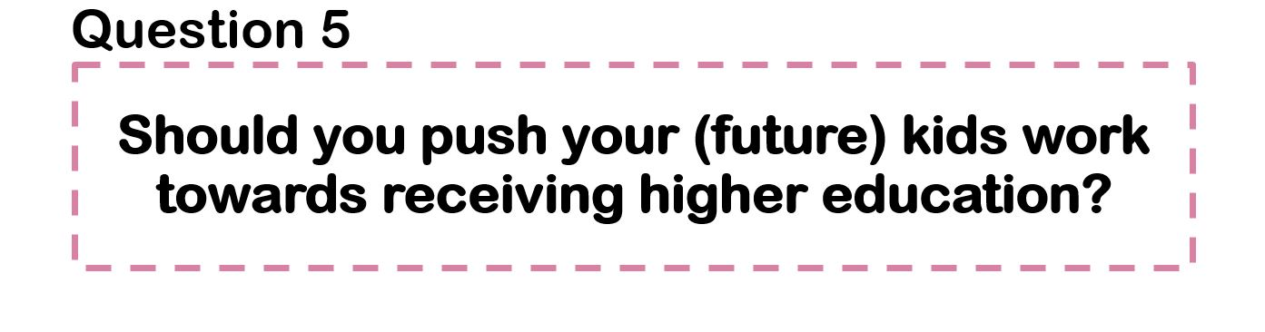

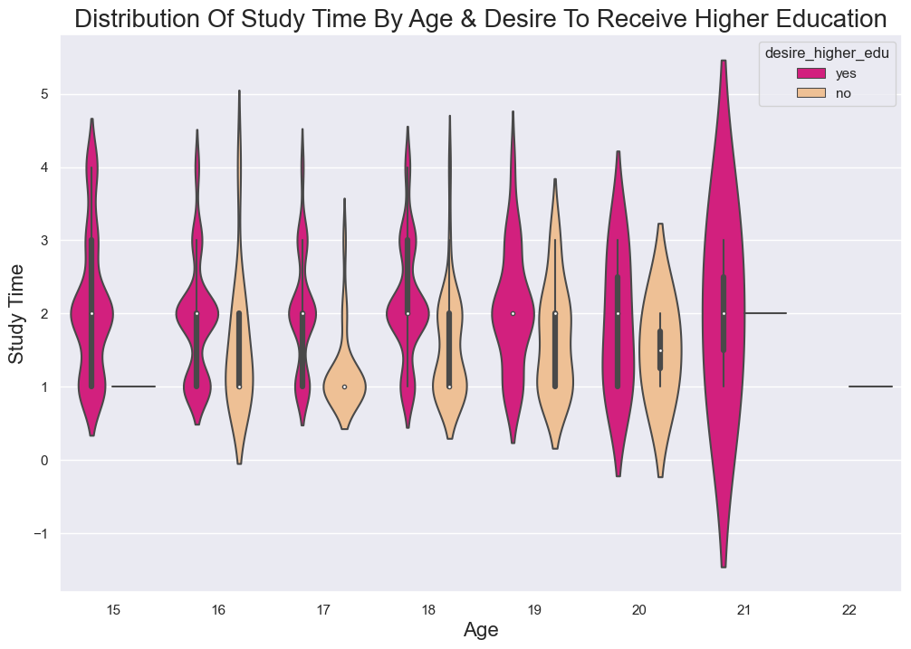
4.7 Final Grade By Desire To Go To College
We can observe that as age increases, there is a greater inclination towards pursuing higher studies.
In the age group of 16 years, a higher amount of study time is associated with a decreased tendency to pursue higher education

Slide 21
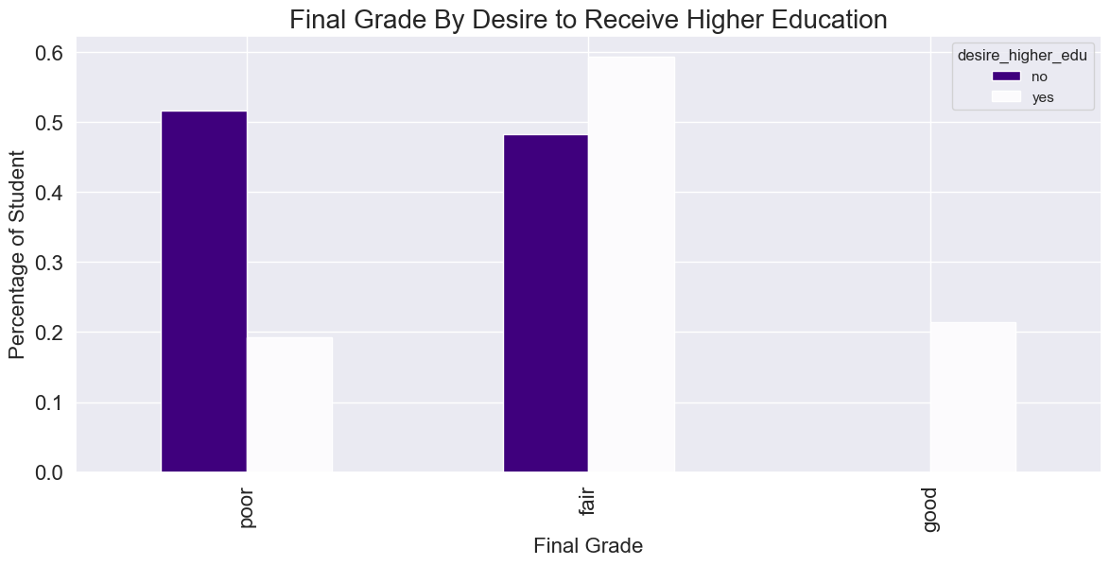
4.7 Final Grade By Desire To Go To College
All students who perform well academically demonstrate a desire to pursue higher education.
The majority of fair students express a desire for higher education.
Most poor students opt not to pursue higher education.

Slide 22
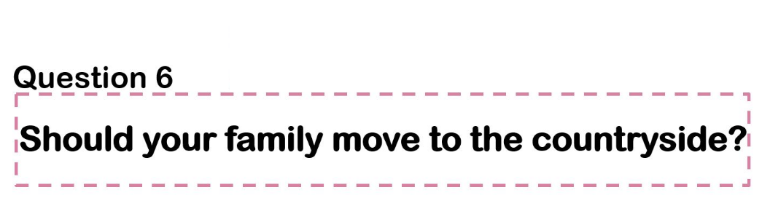
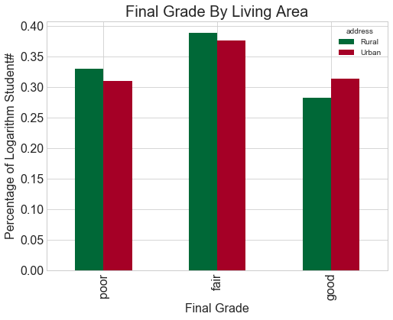
4.8 Final Grade By Living Area
A majority of the students belong to urban areas, and it is observed that urban students tend to have better academic performance.

Slide 23
5. Conclusion
Jupyter Notebook is commonly utilized for conducting Exploratory Data Analysis (EDA) with the assistance of pandas profiling.
We employed popular Python libraries such as Pandas, Numpy, as well as packages like Matplotlib and Seaborn to gain deeper insights into the data
The preprocessing step facilitates a better understanding of missing values, outliers, and irregularities within the data, aiding in data analysis and interpretation.
Additionally, we utilize the pandas profiling feature to generate a comprehensive HTML report that encompasses all the information about the different features within the dataset.
Furthermore, we gained knowledge on creating new features, which subsequently aids us in achieving improved prediction accuracy and performance.
The majority of students have received a grade of Fair
The romantic status exhibits a noteworthy correlation with the final grade
We can also observe that students who perform well academically tend to have lower alcohol consumption levels, whereas students with poor or fair academic performance have higher levels of alcohol consumption.
When comparing the educational backgrounds of both fathers and mothers, it becomes evident that the academic performance of students is greatly influenced by the mother's level of education.
There exists a significant correlation between the frequency of socializing with friends and students' final performance.
We can observe that as age increases, there is a greater inclination towards pursuing higher studies.
A majority of the students belong to urban areas, and it is observed that urban students tend to have better academic performance.
This analysis will assist us in selecting an appropriate machine learning model to predict the performance of students.
​

